Slide 1
Logical Data Modelling
Entity | Attribute | Data Type

Slide 2
Outcomes
Define the term ERD
Give a definition for logical data modelling terms such as ENTITY, ATTRIBUTE, PRIMARY KEY, FOREIGN KEY, RELATIONSHIP
Identify THREE types of RELATIONSHIP
Create an ERD for a specific system
Show optional relationships on an ERD
Resolve many to many relationships on an ERD
Identify attributes for a specific system

Slide 3
Outcomes
Define the term NORMALISATION
Name TWO reasons why data should be normalised
Normalise data for specific systems
Produce a data dictionary for a specific system showing entities, attributes and relationships

Slide 4
Specific terms used
attribute
entity
relationship
key

Slide 5
1. Entity Relationship Diagrams
A logical data modelling tool

Slide 6
Purpose of an ERD
“A diagrammatic way of representing an IT system from a logical point of view, which can be used as a basis for building a physical model … such as a database”

Slide 7
“looks at data in a system and shows the relationship between chunks of related data”
“shows entities and the relationships between them in the system”

Slide 8
What does one look like?
COURSE
STUDENT
ENROLMENT

Slide 9
What symbols are used?
Entities are represented by a rectangle with rounded corners. It must be in the SINGULAR in CAPITALS.
ENTITY NAME
A MANDATORY RELATIONSHIP is represented by a straight line
A OPTIONAL RELATIONSHIP is represented by a small circle on the line
A MANY RELATIONSHIP is represented by a crow’s foot

Slide 10
Entities

Slide 11
Entity
An entity is: a real world object – it can model a physical thing ( book, student,patient), an organisational thing (budget) or a process/event ( fault, exam, apopintment).
Eventually it will equate to a table in an Access DB.
N.B. an occurrence of an entity relates to one record in your DB

Slide 12
Steps to finding the entities
To identify an entity, underline the nouns in a given scenario and then use the following checklist to make sure that it is really an entity.
An ENTITY must:
• be of significance to the system
• have more than one occurrence
• be uniquely identifiable
• have data that can be held about it
SOME EXAMPLES ARE: book, student, exam

Slide 13
Relationships

Slide 14
Relationship
A Relationship: represents the link between entities.
3 types
Eventually it will equate to the relationship in an Access DB

Slide 15
Relationship
The THREE types are:
one to one
one to many
many to many.
1:1
1:m
m:m

Slide 16
Relationship
Examples are:
one to one
one to many
many to many.
EMPLOYEE
COMPANY CAR
WARD
PATIENT
AUTHOR
BOOK

Slide 17
OPTIONAL Relationships
Little circle means optional
You can also get OPTIONAL relationships
Little line means mandatory

Slide 18
How to resolve a many to many relationship
Create a linking entity between the two entities at the end of the many to many relationship line

Slide 19
Example of how to resolve a many to many relationship
PATIENT
DRUGS
PATIENT
DRUG
PRESCRIPTION

Slide 20
BEWARE!!!!!!!!!!
Sometimes difficult to work out the type of relationship ~
e.g. whether an employee uses the same company car at different time.
You need to make assumptions about things e.g. that the employee only drives the current company car and it does not matter which one they are in!!!!!!!!!
PATIENT
DRUG
PRESCRIPTION

Slide 21

STEPS TO CREATING AN ERD
1. To identify an entity, underline the nouns in a given scenario
An ENTITY must:
        • be of significance to the system
        • have more than one occurrence
        • be uniquely identifiable
        • have data that can be held about it
2. Draw entity box ( rectangle with rounded corners)
3. Add entity name in box (in the SINGULAR in CAPITALS)
4. Draw in relationship lines
5. Add crow’s feet for many side of relationships
6. Check for many to many relationships and resolve

Slide 22
2. Creating a data dictionary

Slide 23
Definition
“a data dictionary is a collection of descriptions of the data objects or items in a data model for the benefit of programmers and others who need to refer to them”

Slide 24
Attributes

Slide 25
Attribute
An Attribute is: properties of an entity e.g. Book entity: title, price (i.e. adds detail to an entity)
It is the “smallest discrete component of a system that is meaningful” . . .. KNOWN AS ATOMIC
Eventually it will equate to the fields in your table in an Access DB.

Slide 26
Attribute
To identify an attribute, underline the nouns in a given scenario and then use the following checklist to make sure that it is really an. attribute
An ATTRIBUTE must:
• . be the smallest meaningful thing in the system
• . describe an entity
SOME EXAMPLES ARE: book title, student name, exam title

Slide 27
DataTypes

Slide 28
Data Types
text
numeric
Boolean
Date/time

Slide 29
Field Lengths

Slide 30
Field Length & Domain
reduce as database are very memory hungry
E.g.
  first name = 15; address = 20
  Date of Birth may only be in the past – 10/2/1990
  Quantity Ordered my not be bigger than 100

Slide 31
Keys

Slide 32

Key
A Key is: a unique identifier for each entity
Eventually it will become the Primary Key in an Access DB to make each record unique.
There are three types of key:
Primary Key ~ a field acting as a unique identifier for each record (row) in a table;
Foreign Key ~ field in one table which is a PK in another table. OR the key of one entity stored a an attribute in another entity to provide a link between entities
Composite Key ~ two fields that make up a PK together.

Slide 33
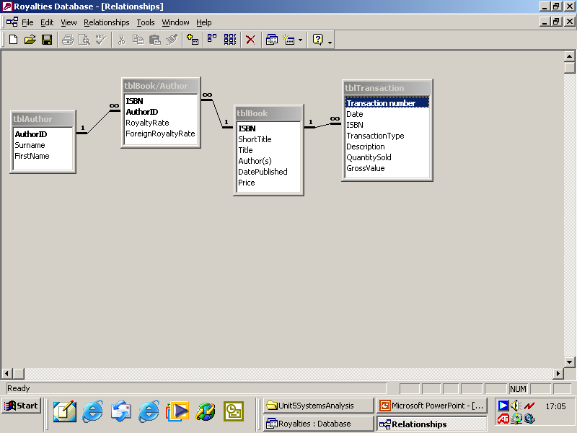
Examples
foreign keys

Slide 34
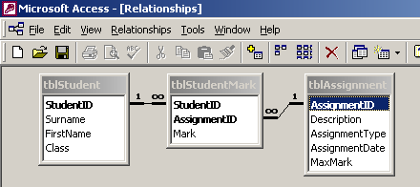
Examples
A composite key

Slide 35
Logical Physical

Slide 36
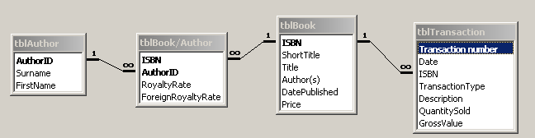
AUTHOR
BOOK/AUTHOR
logical
BOOK
TRANSACTION
physical

Slide 37
where ever there is a crow’s foot
AUTHOR
BOOK/AUTHOR
BOOK
TRANSACTION
Where are the foreign keys?

Slide 38
3. Normalisation

Slide 39
Normalisation
“ the process of ensuring that a database is designed in the best possible way”

Slide 40
Stages
first
second
third
fourth

Slide 41
Why is it needed?
Remove repeating data (fields) and make sure that there are NO many to many relationships
Improve database efficiency by making it quicker e.g. to input data and output information
To decrease or avoid duplication of data in different tables
To allocate keys e.g. Primary Keys and Foreign Keys
Establish data dependencies
To minimise errors between data items e.g. different spelling of surname in different parts of the database

Slide 42
How to layout the information
Table format
ENTITY
ATTRIBUTE
(field name)
DATA TYPE
FIELD LENGTH
written format
AUTHOR (Author ID, Surname, Initials)
BOOK (ISBN, Title, Date Published, Price)
Entity
PK
Attributes

Slide 43
HINT: your field names must be what is called ‘atomic’ i.e. they can’t be broken down any further.

Slide 44
STEPS
Look at the ERD.
Write down each entity name that you have in your ERD in the table below.
List the attributes of each entity.
Add the data types.
Add suitable field lengths.
Decide on a suitable Primary Key.
Work out which attributes (fields) will be the Foreign Keys.

Slide 45


Driving School Database

Slide 46
SCENARIO
Pass-It is a small driving school in Brightonshire with THREE Instructors. They currently have a manual system of recording details of students wanting lessons and which type of lesson they take.
Pass Plus is a lesson that they can take after they have passed their test to practice driving on the motorway for example.
The student rings the school and drop into the office to book lessons. They are issued with a membership card when they book their first lesson. They are also asked where they want to be collected from and dropped off.

Slide 47
LESSON TYPE | COST
Introductory | £12.00
Standard | £15.00
Pass Plus | £17.00
Test | £25.00

Slide 48
SCENARIO
The user is Mr Doug Jones, who is the owner of the driving school. There are a number of full time instructors and around 70 students.
Mr Jones is interested in improving his record keeping, particularly as he stores details of lessons that have been booked and how he issues information to instructors. At present all these details are stored in a diary which is kept in his office at home.

Slide 49
The system will store many different types of information including:
details of students and instructors
details of lessons booked for each day
It will also improve the image of the driving school.
Mr Jones needs to know which students have lessons each day, with which instructor and at which times. Details of the pick up points and drop off points will also need to be stored. Data must be able to be entered and retrieved easily.

Slide 50
Structured Analysis

Slide 51
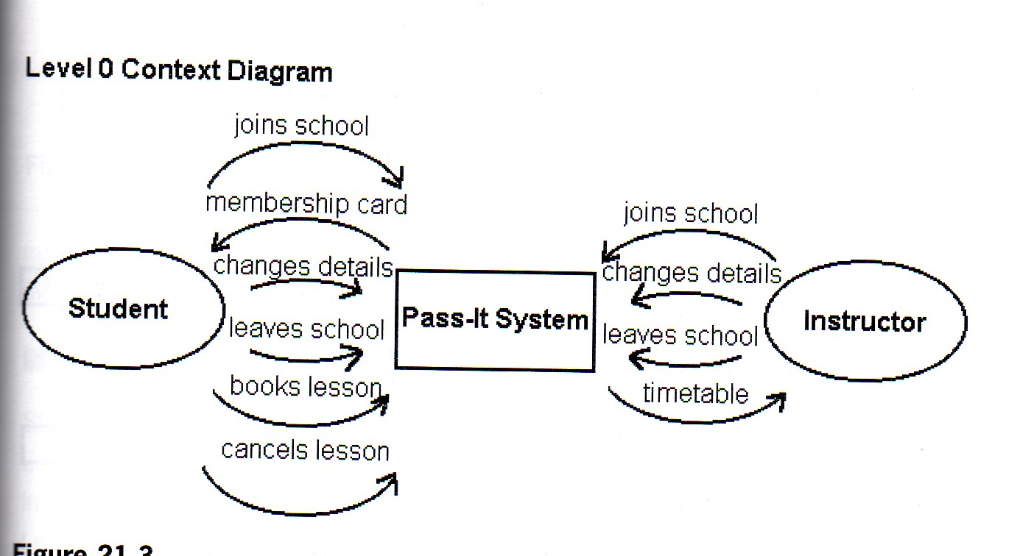

Slide 52
